Slide 1

INNOVATION
PRODUCTS

Slide 2


TEAM
GROUP 2
Pavani Pragada
Harichandana Gonuguntla
Joshua Hawley

Slide 3

PRODUCT INNOVATION
THE TASK
INTRODUCING NEW PRODUCTS
Broader Customer Segments
Trends such as health-consciousness and sustainability
Crucial For Revenue Growth
Keeps customer engagement fresh and looking for new products
Enhance Brand Appeal
Revitalizes sales and marketing efforts – leading to increased visibility

Slide 4

No one EVER made a decision because of a number. They need a STORY.
Daniel Kahneman

Slide 5
THE PROCESS
DECISION PROCESS
01 Examine Data
02 Model Creation
Taking a closer look at the available data
Writing the models for later analysis
04 Question Analysis
03 Model Refinement
Answering questions with existing results
Tuning and adjusting the hyperparameters

Slide 6
MODELING

Slide 7
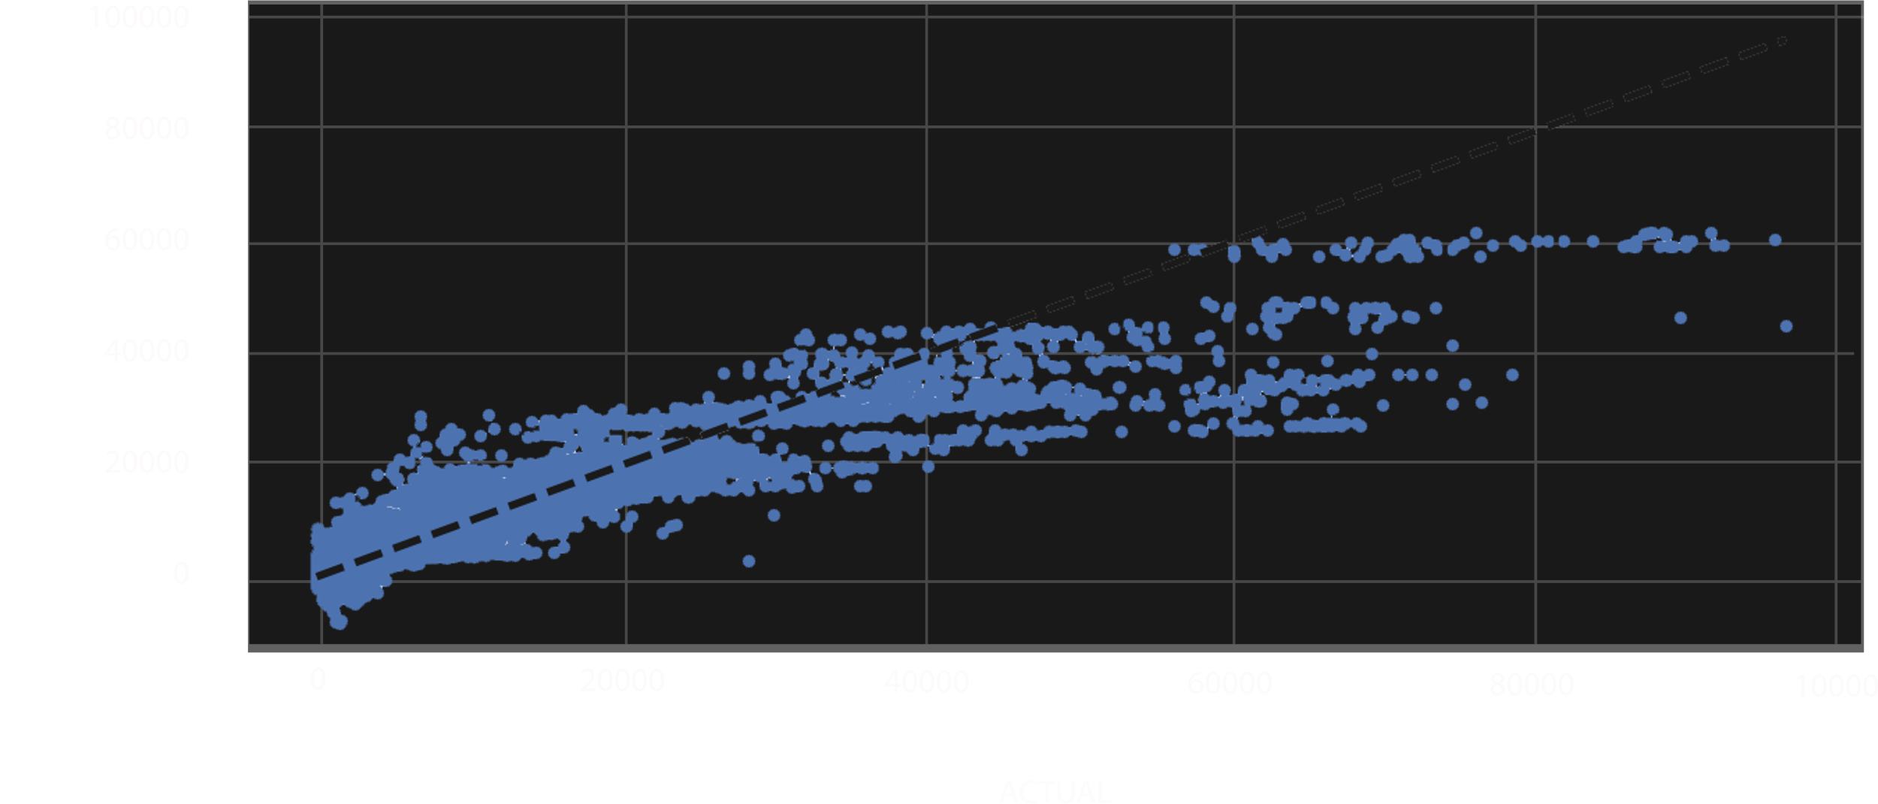
PREDICTED v ACTUAL
Notes:
The dashed line represents the line of perfect prediction, where the predicted values exactly match the actual values. The closer the dots are to this line, the more accurate the predictions.
In this plot, we can see that most of the dots are clustered around the line, which suggests that the model has a good fit to the data

Slide 8
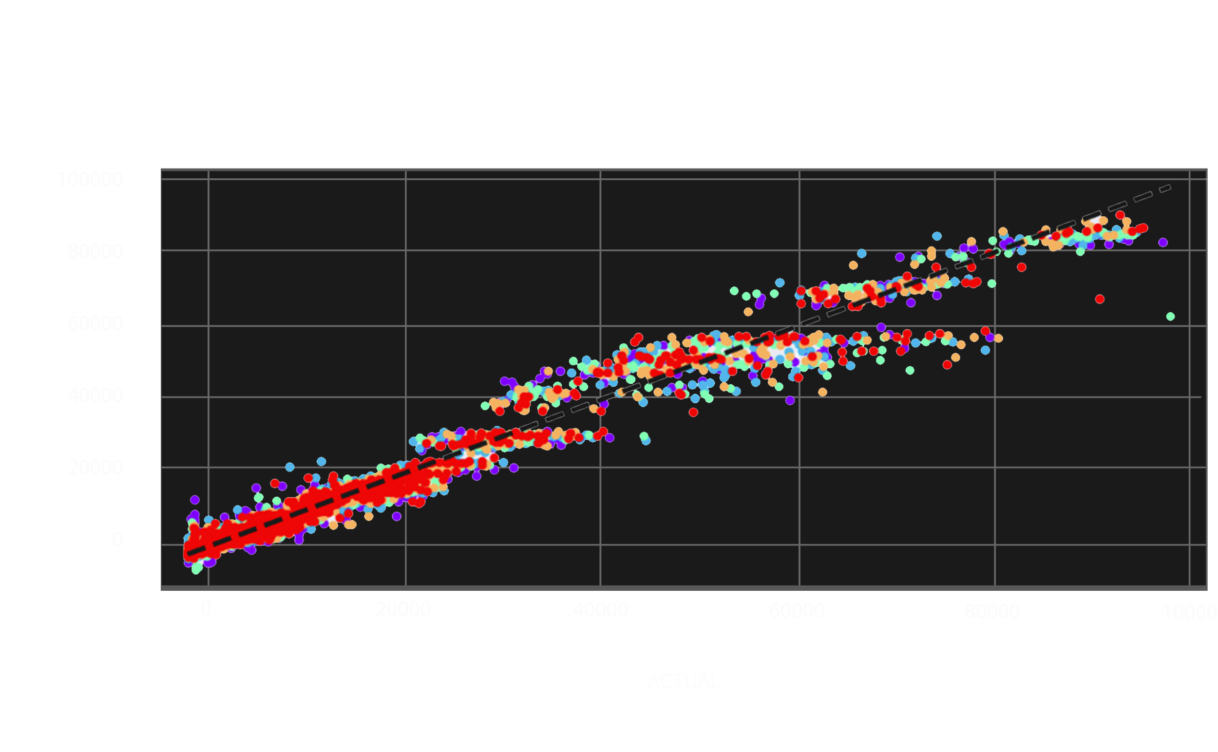
PREDICTED v ACTUAL
K-fold Cross Validation
Notes:
The dashed line represents the line of perfect prediction, where the predicted values exactly match the actual values. The closer the dots are to this line, the more accurate the predictions.
The below chart shows the change between the previous iteration and a K-Folds CV of the data.

Slide 9
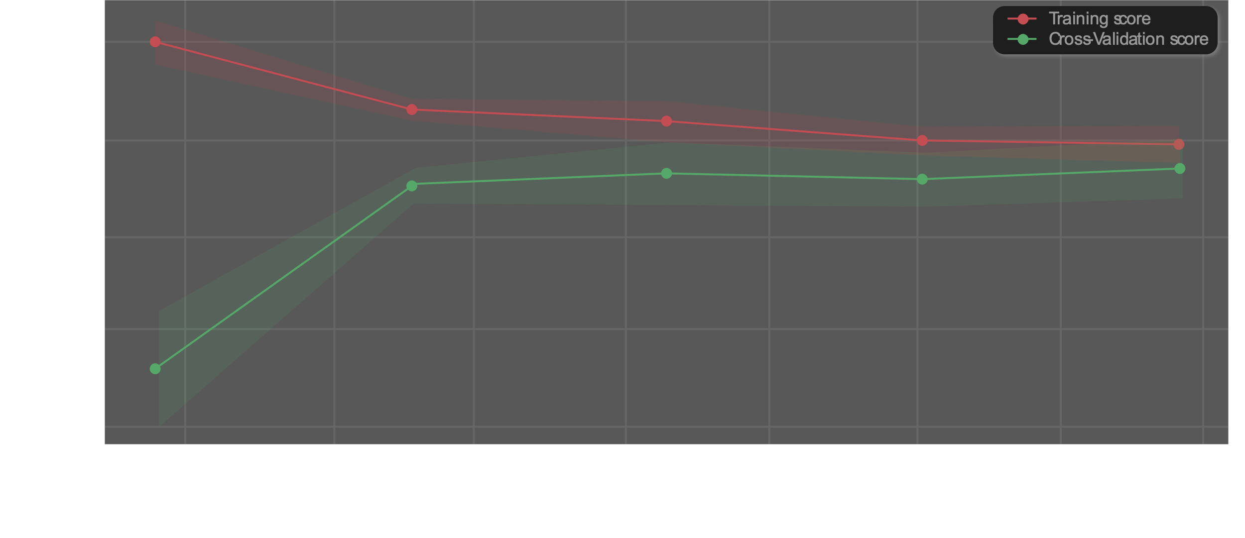
LEARNING CURVE

Slide 10
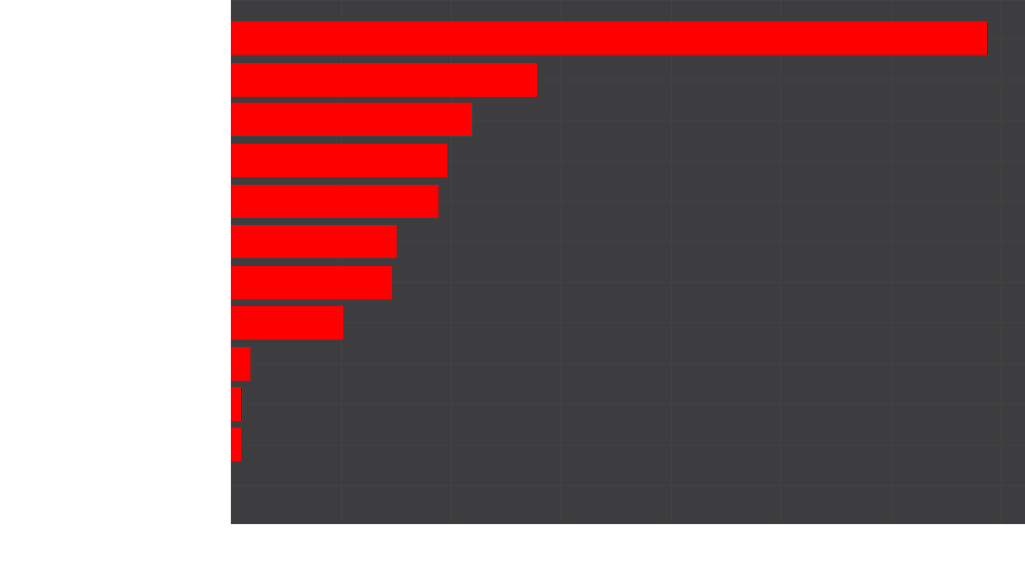
FEATURE IMPORTANCE

Slide 11
STATISTICAL AND PREDICTIVE
MODEL ANALYSIS

Slide 12
Random Forest Metrics
RESULTS FROM RANDOM FOREST MODEL
0.77
R-Squared
Execution Time
90 mins
R-squared Score
Time to run the model
RMSE
MAE
Mean squared error
102.65
88.34
Mean Absolute Error

Slide 13
XGBoost Metrics
RESULTS FROM XGBOOST
0.96
R-Squared
Execution Time
141 secs
R-squared Score
Time to run the model
RMSE
MAE
Mean squared error
169.29
24.03
Mean Absolute Error

Slide 14
QUESTIONS

Slide 15
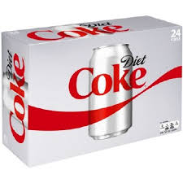
Which 13 weeks of the year would this product perform best in the market? What is the forecasted demand, in weeks, for those 13 weeks?
DIET SMASH PLUM 11SMALL 4ONE
Starting from week 32 and spanning the next 12 weeks suggests that the late Summer through Autumn might be the peak season for this product.
Notes:
Week 32 is the second week of August. Avg demand 381

Slide 16
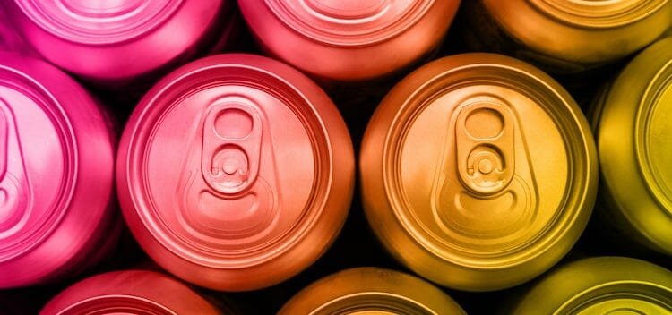
Which 13 weeks of the year would this product perform best in the market? What is the forecasted demand, in weeks, for those 13 weeks?
DIET VENOMOUS BLAST ENERGY DRINK KIWANO 16 LIQUID SMALL
The forecasted demand of this product, following historical trends, would be highest from week 47 which spans from late fall into winter, crossing over into the following year.
Notes:
Week 47 is the last week of November. 2329 is Avg demand

Slide 17
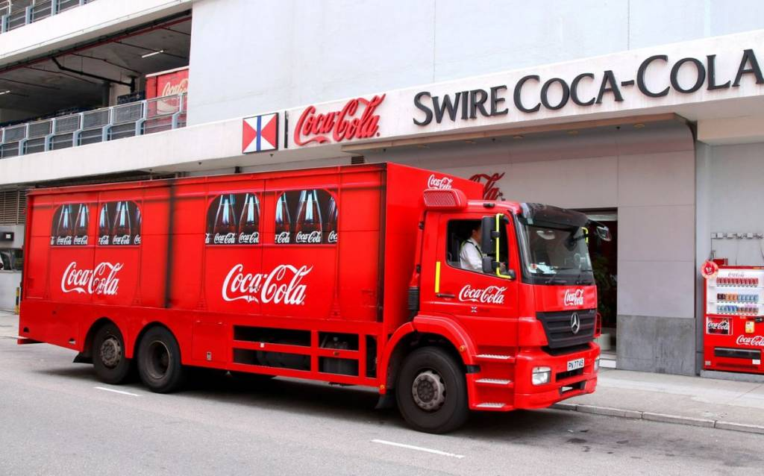
Swire plans to release this product for 13 weeks, but only in one region. Which region would it perform best in?
GREETINGLE HEALTH BEVERAGE WOODSY YELLOW .5L 12ONE JUG
The product is predicted to perform best in the "Midwest" region. All the top 13 predicted demand values belong to the "Midwest" region.
Notes:
2998 is Avg

Slide 18
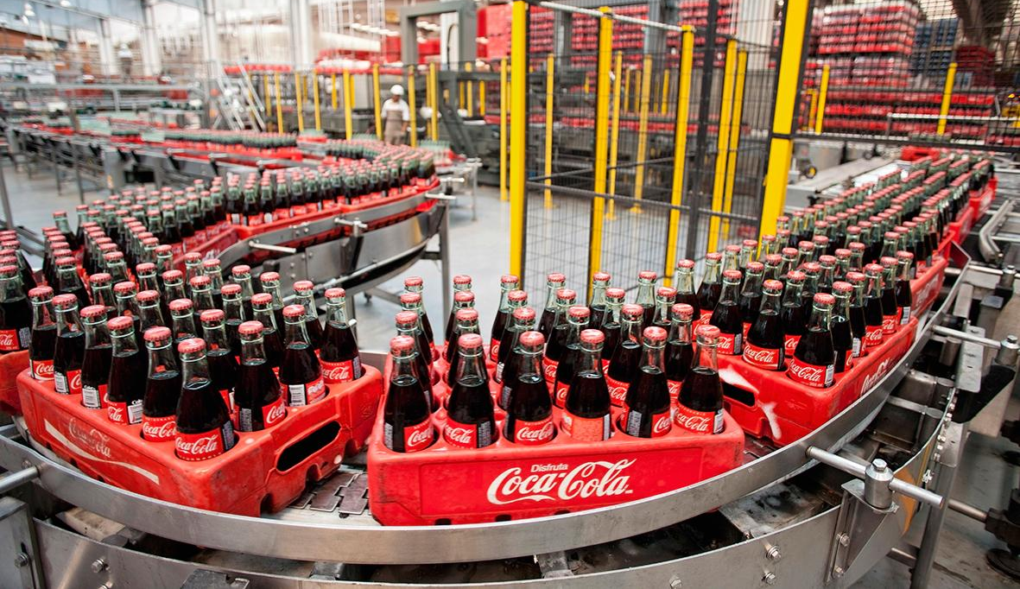
Lessons Learned
Targeted approach to the overall problem
Breaking down the dataset further
A deeper understanding of the process

Slide 19
THANKS
FOR LISTENING

